Slide 1
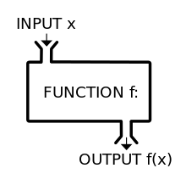
Thinking Functional
What do you mean?

Slide 2

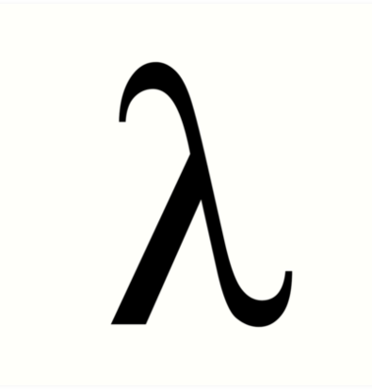
Functional Programming
FP is a way of writing code with the mathematical approach
Never change any state or mutating data
Always the programming is done with declarations and expressions instead of statements.

Slide 3

What is a function?
A function creates a relationship between a set of variables such that for each set of input there is a unique set of output's

Slide 4
Function Characteristics
A function consist of:
The input
The relationship
The output
Input | Relationship | Output
(3,2) | (_.1 * 2) + (_.2 * 3) | 12

Slide 5
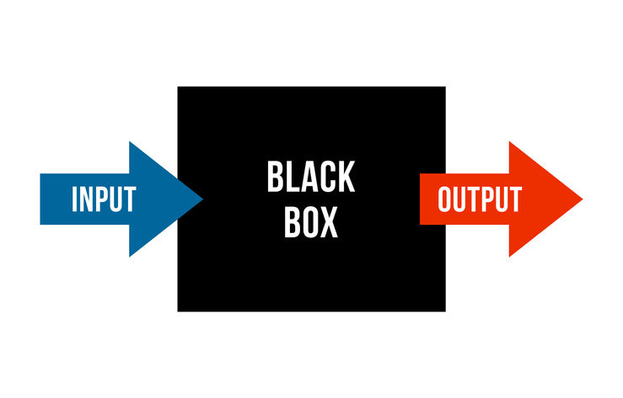
Lambda Calculus
Express the abstract behaviour of a function

Slide 6
Functions in programming are categorized:
Pure Functions
Impure Functions

Slide 7
Pure vs Impure

Slide 8
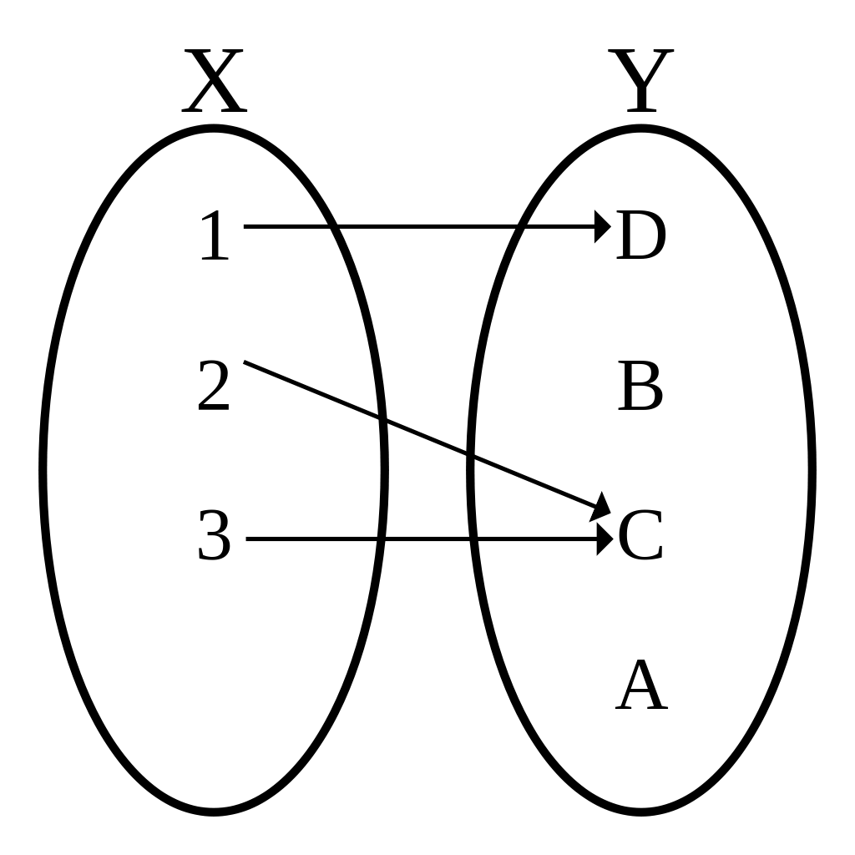
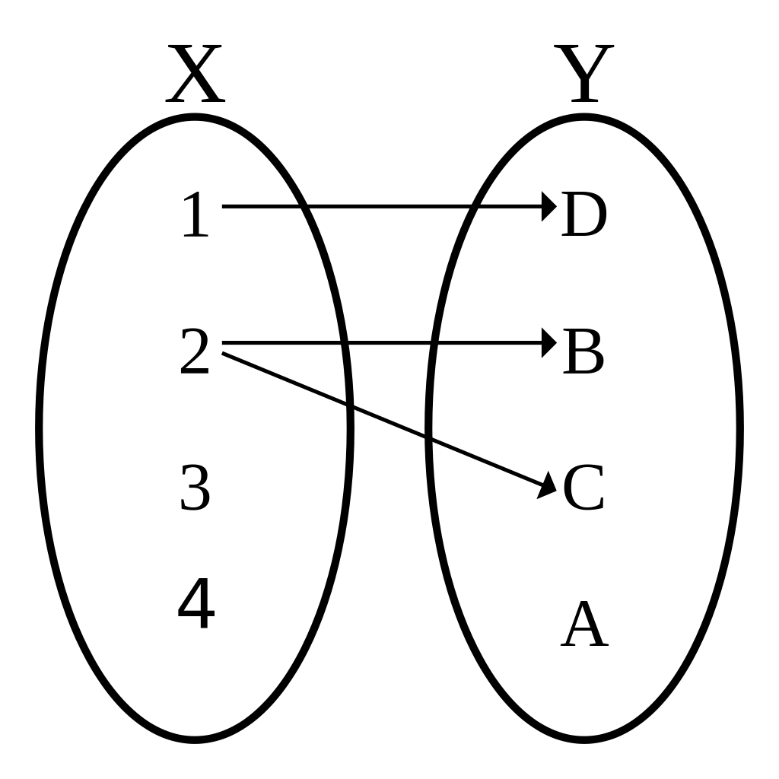
Pure
vs Impure

Slide 9
Exercises:
Functions | Pure or Impure
def myFunction(a: Int): Int = a
def myFunction(): Double = Math.random()
def myFunction(a: Int): Int = { var x = 2 x * a }
def myFunction(a: Int, b: Double): Double = a * b
def myFunction(a: Double, d: Double): Double = a / d

Slide 10
Exercises:
Functions | Pure or Impure
def myFunction(emp: Employee, money: Double): Double = { emp.setSalary(money) emp.getSalary() }
def myFunction(host: String, port: Int): DbConnenction = { cseDriver.newConn(host,port) }
def myFunction(emp: Employee): Unit = { println(emp.name) }

Slide 11

Why am I showing you that ??
Hmm Still don’t get it!
Scala doesn’t notify you when there is an impure function implementation

